Slide 1
TE Mini Project : Insurance Fraud Detection
Group Members:
118A1003 Aditya Sadashiv
118A1019 Dinesh Choudhary
118A1028 Saravanan Iyer
Project Guide : Prof. Aarthi Boyanapalli

Slide 2
Introduction:
In this Project we will try to classify whether an Insurance claim is fraudulent or not using Machine Learning. The Machine Learning Algorithms which we have used in our project are XGBoost Classifier,Linear Regression,RF,SVM.

Slide 3
Literature survey
A paper titled “Medicare Fraud detection using machine learning methods” [2].
1. The Supervised learner which includes Random forest, Deep Neural Networks, Naïve Bayes Etc.,
2. The Unsupervised learner includes KNN. Autoencoder etc
A paper titled “Detecting insurance fraud by using Data mining Techniques” [4]. Makes use of 3 algorithms they are Bayesian Network, C4.5, Decision tree-based algorithm for predicting and analyzing fraud pattern from data.

Slide 4
Objective
The goal of this project is to build a model that can detect auto or motor insurance fraud. The challenge behind fraud detection in machine learning is that frauds are far more common as compared to legit insurance claims.

Slide 5
Potential Business Problems
Identifying fraudulent claims is important for any Insurance Company as they would not want to pay out on claims that are not legal
For Auto Insurance, fraudulent claims may arise due to someone claiming for damages for an accident, when no accident might have taken place
Traditionally, insurance companies have a claim investigation team to investigate claims and determine whether or not they are fraudulent.
However, with the increase in power of computing and advanced analytics, insurance companies are trying to come up with automated solutions to determine if a claim is fraudulent or not as the previous methods are prone to errors.

Slide 6
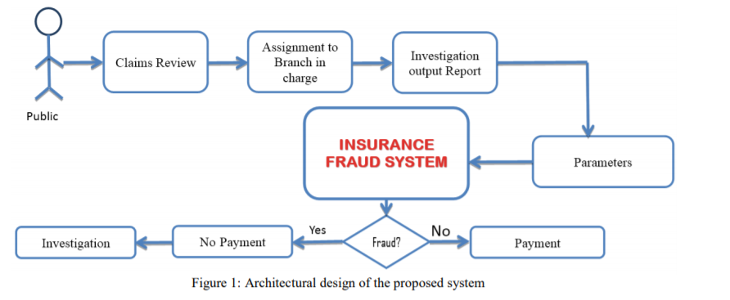
Proposed System

Slide 7
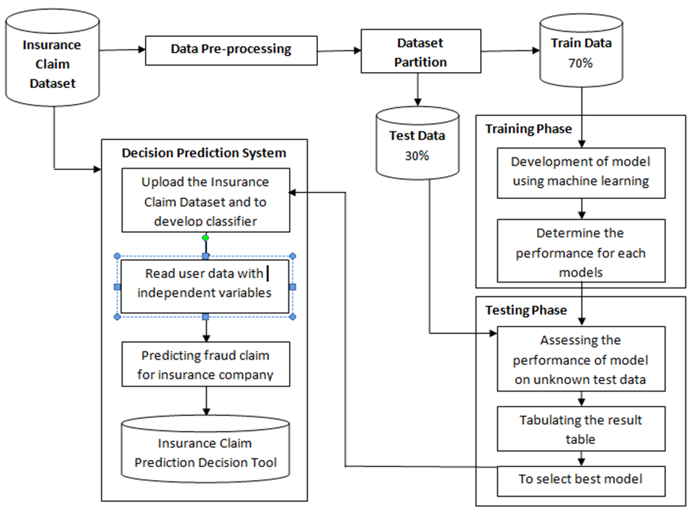
Methodology

Slide 8
Features of the dataset
1000 Datapoints
38 features:
13 numerical features
25 categorical features
One Target Variable: Fraud_Reported
Yes – 247 Count
No – 753 Count
Dataset split into Train and Test set for modelling purpose. Train set had 800 datapoints. Test set had 200 datapoints.

Slide 9
Data Cleaning and Preprocessing
Step 1 : Import the libraries
Step 2 : Import the data-set
Step 3 : Check out the missing values
Step 4 : See the Categorical Values
Step 5 : Splitting the data-set into Training and Test Set
Step 6 : Feature Scaling

Slide 10
Data Cleaning and Preprocessing
Three columns had ‘?’ (missing values):
Collision Type
Property Damage
Police Report Available

Slide 11
Data Cleaning and Preprocessing
Encoding categorical data
Since machine learning model completely works on mathematics and numbers, but if our dataset would have a categorical variable, then it may create trouble while building the model. So it is necessary to encode these categorical variables into numbers
One hot encoding is the technique which is used to convert categorical variables to numerical variables

Slide 12
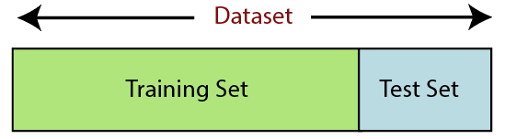
Data preprocessing and cleaning
5 . Splitting the dataset
Every dataset for machine learning model must be split into separate sets training set and test dataset

Slide 13
Data preprocessing and cleaning
6. Feature scaling
Feature scaling marks the end of the data preprocessing in Machine Learning. It is a method to standardize the independent variables of a dataset within a specific range. In other words, feature scaling limits the range of variables so that you can compare them on common grounds.

Slide 14
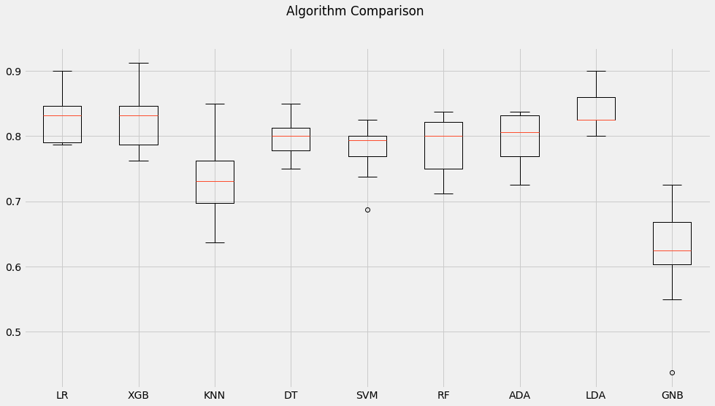
Model Performance and Comparison

Slide 15
Comparison
Algorithm | Accuracy(%)
XGB | 82.3
LR | 82.62
KNN | 72.5
DT | 78.75
SVM | 78
RF | 78.5
ADA | 79.7

Slide 16
Test performance of Model
Hence we will keep the fitted XGB model as the final model for our project.
Parameters | Accuracy | Cohen Kappa | Recall
XGB | 82.0 | 0.58 | 84.31
LR | 80.5 | 0.49 | 62.75

Slide 17
Conclusion:
Insurance fraud detection is a rough task, this industry has grappled with challenges of insurance claim fraud from the very beginning. Proposed system aims at developing a system that can help to recognize possible frauds with peak magnitude of accuracy. Proposed system predicts whether the claimed insurance is “FRAUD” or “GENUINE”. Thus helping the insurance companies to spot frauds with fewer amount of time and with good accuracy rate

Slide 18
References:
Dal Pozzolo, A., Caelen, O., Le Borgne, Y. A., Waterschoot, S., & Bontempi, G. (2014). Learnedlessons in credit card fraud detection from a practitioner perspective. Expert systems with applications, 41(10), 4915–4928.
http://www.jcreview.com/fulltext/197-1583405087.pdf
https://www.researchgate.net/publication/326102521_Detection_of_Automobile_Insurance_Fraud_Using_Feature_Selection_and_Data_Mining_Techniques

Slide 19
Thank You

